Slide 1
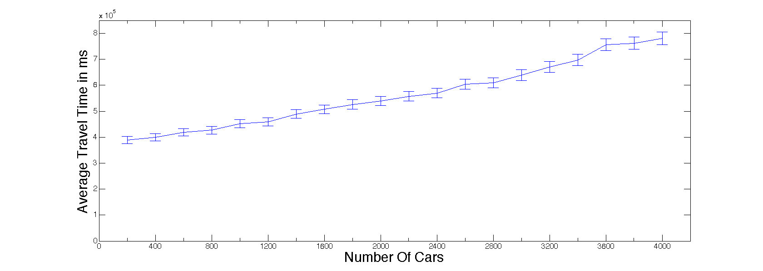
Simulation Results
Increase of number of cars increases travel time

Slide 2
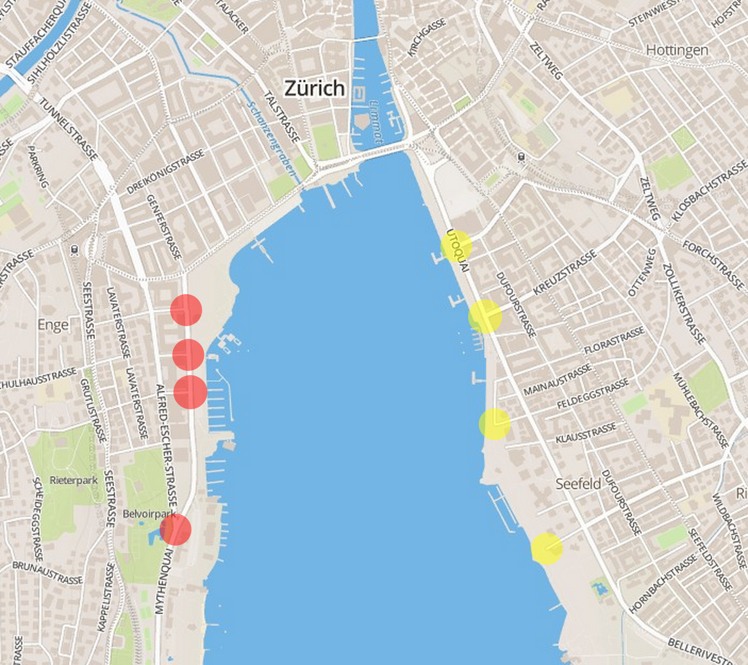
Simulation Results
16 possible positions for the tunnel were considered

Slide 3
Simulation Results
start node | end node | 500 cars | 1000 cars | 2000 cars
Left 1 | Right 1 | 398570 | 447040 | 576070
Left 1 | Right 2 | 419070 | 444740 | 542180
Left 1 | Right 3 | 410970 | 453580 | 564700
Left 1 | Right 4 | 404440 | 441430 | 541860
Left 2 | Right 1 | 420470 | 453320 | 544150
Left 2 | Right 2 | 423860 | 443500 | 533280
Left 2 | Right 3 | 421850 | 435940 | 539880
Left 2 | Right 4 | 399220 | 450070 | 555110
Left 3 | Right 1 | 409720 | 441690 | 527970
Left 3 | Right 2 | 414000 | 447560 | 520660
Left 3 | Right 3 | 393170 | 447390 | 536280
Left 3 | Right 4 | 401790 | 443810 | 553050
Left 4 | Right 1 | 417620 | 440940 | 553870
Left 4 | Right 2 | 424000 | 440600 | 533280
Left 4 | Right 3 | 407270 | 439130 | 531330
Left 4 | Right 4 | 412490 | 441830 | 536610
---- | ---- | 400872 | 471644 | 545545

Slide 4
Conclusion
Every tunnel improved results for 1000 cars
Hard to say which tunnel is best in general
Change to no tunnel is not significant for 500 and 2000 cars

